Slide 1

STATISTICS FOR DATA SCIENCE
Concepts • Formulas • Excel • Examples

Slide 2
Why Do We Use Statistics in Data Science?
Turn raw data into meaningful information and insights
Summarize data: What is typical? How much variation?
Understand relationships between variables
Make decisions under uncertainty using samples
Foundation for ML models: feature understanding, assumptions, evaluation
Notes:
Explain that statistics is the language of data; before ML, we must understand and summarize data.

Slide 3
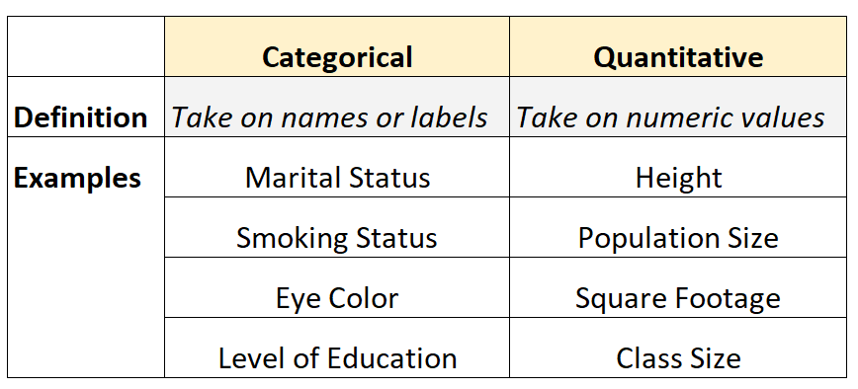
Types of Data – Quick Recap
Qualitative (Categorical)
  • Nominal: categories without order (e.g., gender, color)
  • Ordinal: ordered categories (e.g., Low/Medium/High)
Quantitative (Numerical)
  • Discrete: counts (e.g., number of items sold)
  • Continuous: measured (e.g., height, weight, temperature)

Slide 4
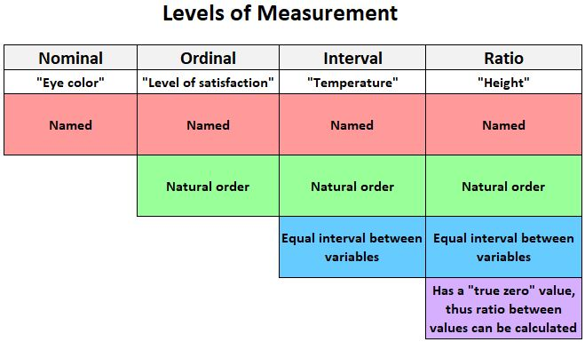
Levels of Measurement (Scale Types)
Nominal: labels only, no order (e.g., Male/Female, City)
Ordinal: order exists, gaps unknown (e.g., 1st, 2nd, 3rd rank)
Interval: numeric, equal intervals, no true zero (e.g., °C temperature)
Ratio: numeric, equal intervals, true zero (e.g., height, weight, sales)
Levels of Measurement: Nominal, Ordinal, Interval and Ratio

Slide 5
Descriptive vs Inferential Statistics
Descriptive Statistics
Summarize and describe the dataset you have
Examples: mean, median, standard deviation, histogram, boxplot
Inferential Statistics
Use sample data to draw conclusions about a larger population
Examples: confidence intervals, hypothesis tests, t-test, chi-square
Start with descriptive
then inferential
then modelling.
In data science

Slide 6
DESCRIPTIVE STATISTICS
What Is Included?
1. Central Tendency: Mean, Median, Mode
2. Dispersion: Variance, Std Dev, Range, Quartiles, Percentiles, IQR, CV
3. Shape: Skewness, Kurtosis, Normal distribution check
4. Data Visualization: Histogram, Boxplot, Bar chart, Scatter plot, Frequency table

Slide 7
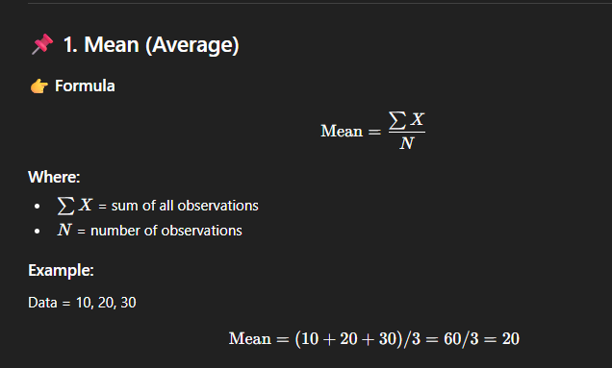
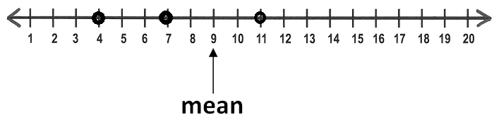
Central Tendency – Mean
Definition: Arithmetic average;
sum of values ÷ number of values.
Formula (sample): x̄ = (Σ xi) / n
Example: Values = 10, 12, 15, 13, 20 → x̄ = (10+12+15+13+20)/5 = 14
In Excel: =AVERAGE(A2:A6)
Use when: data is roughly symmetric and no extreme outliers.

Slide 8
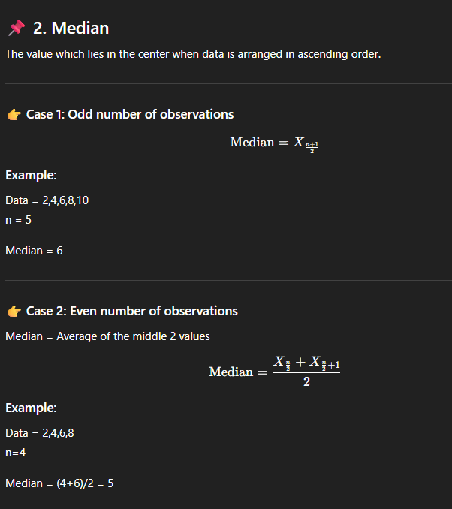
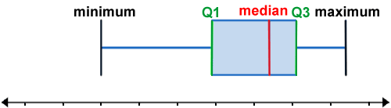
Central Tendency
Median
Definition: Middle value when data is sorted.
If n is odd: median is middle value; if even: average of two middle values.
Example: 5, 7, 9, 12, 100 → Median = 9 (more robust than mean with outlier 100)
In Excel: =MEDIAN(A2:A6)
Use when: data is skewed or has outliers.

Slide 9
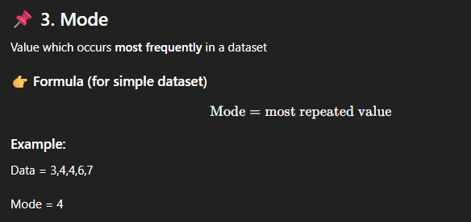
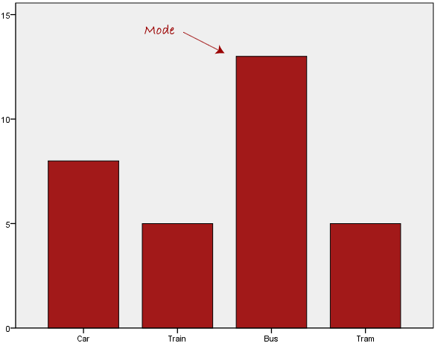
Central Tendency
Mode
Definition: Most frequently occurring value in the dataset.
Example: 1, 1, 2, 3, 3, 3, 4 → Mode = 3
Useful for: categorical data (e.g., most common category).
In Excel: =MODE.SNGL(A2:A8)
Can have: no mode, one mode, or multiple modes.

Slide 10
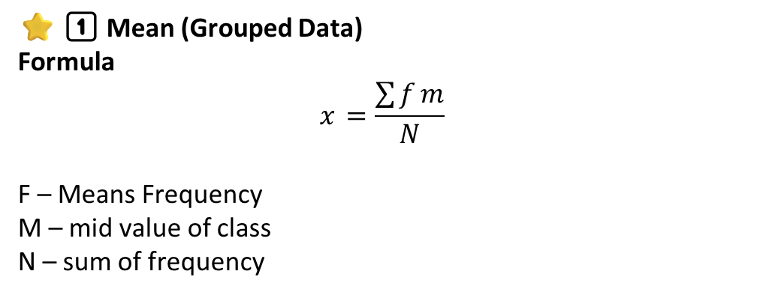
continuous Data – Mean
Class Interval | Frequency
0–10 | 4
10–20 | 6
20–30 | 10
30–40 | 5
40–50 | 5
⭐ 1️⃣ Mean (Grouped Data)
Formula
$$\overset{}{x}=\frac{\sum{f}m}{N}$$
F – Means Frequency
M – mid value of class
N – sum of frequency

Slide 11
Step-1: Find Mid Values
Class | F | Mid value (m)
0–10 | 4 | 5
10–20 | 6 | 15
20–30 | 10 | 25
30–40 | 5 | 35
40–50 | 5 | 45
Step-2: Find f×m
Class | F | m | f×m
0–10 | 4 | 5 | 20
10–20 | 6 | 15 | 90
20–30 | 10 | 25 | 250
30–40 | 5 | 35 | 175
40–50 | 5 | 45 | 225
 | N = ΣF = 30 |  | Σfm = 760
Σfm = 20 + 90 + 250 + 175 + 225
Σfm = 760

Slide 12
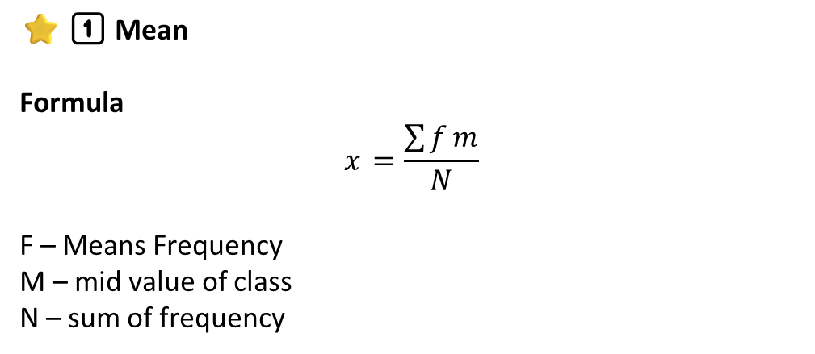
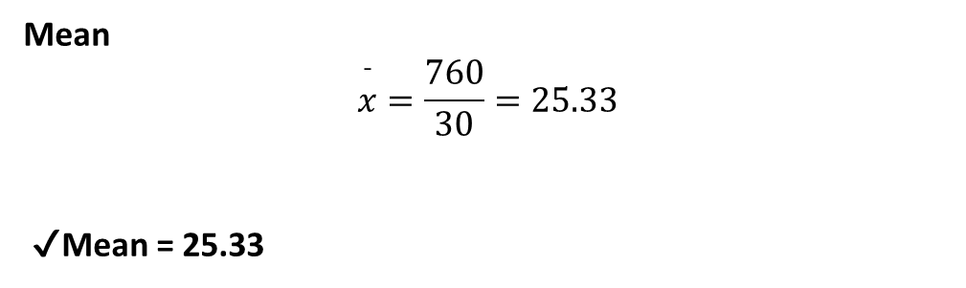
⭐ 1️⃣ Mean
Formula
$$\overset{}{x}=\frac{\sum{f}m}{N}$$
F – Means Frequency
M – mid value of class
N – sum of frequency
Mean
$$\overset{ˉ}{x}=\frac{760}{30}=25.33$$
✔ Mean = 25.33

Slide 13
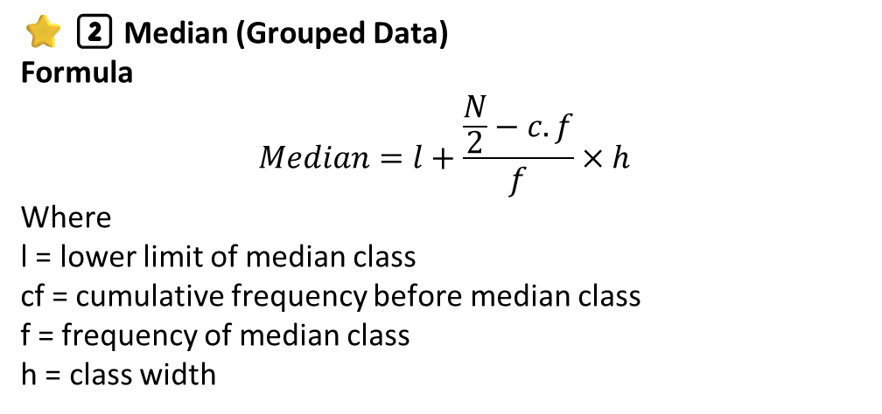
Central Tendency
Median
⭐ 2️⃣ Median (Grouped Data)
Formula
$$Median=l+\frac{\frac{N}{2}−c.f}{f}×h$$
Where
l = lower limit of median class
cf = cumulative frequency before median class
f = frequency of median class
h = class width
Class Interval | Frequency
0–10 | 4
10–20 | 6
20–30 | 10
30–40 | 5
40–50 | 5

Slide 14
Step-1: N/2
N = 30
N/2 = 15
Step-2: Find cumulative frequency
Class | f | c.f
0–10 | 4 | 4
10–20 | 6 | 10
20–30 | 10 | 20
30–40 | 5 | 25
40–50 | 5 | 30
Median class = 20–30
(because c.f just crosses 15)

Slide 15
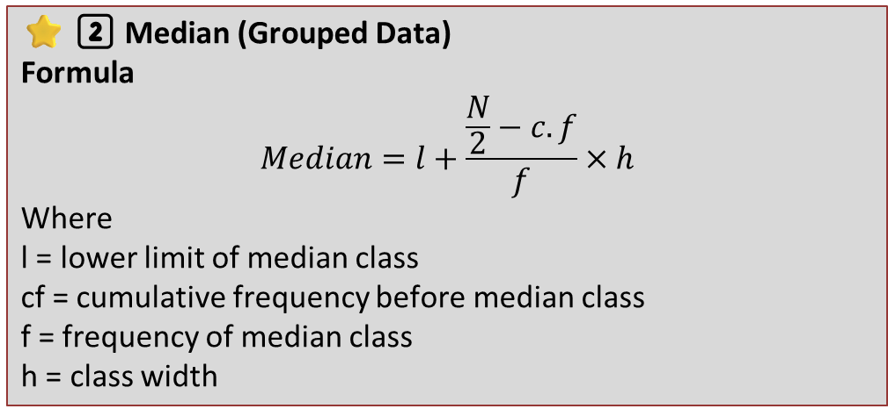
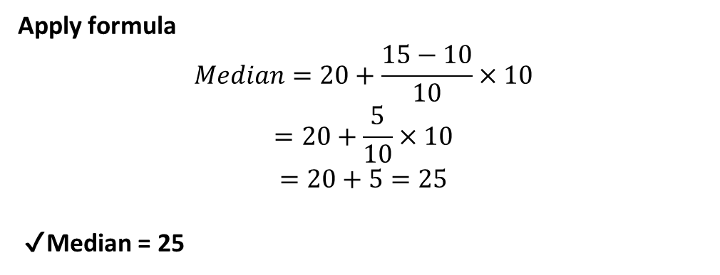
⭐ 2️⃣ Median (Grouped Data)
Formula
$$Median=l+\frac{\frac{N}{2}−c.f}{f}×h$$
Where
l = lower limit of median class
cf = cumulative frequency before median class
f = frequency of median class
h = class width
Assign values
l = 20
cf = 10
f = 10
h = 10
Apply formula
$$Median=20+\frac{15−10}{10}×10$$
$$=20+\frac{5}{10}×10$$
$$=20+5=25$$
✔ Median = 25

Slide 16

Central Tendency
Mode
Mode (Grouped Data)
Formula
$$Mode=l+\frac{f_{1}−f_{0}}{2f_{1}−f_{0}−f_{2}}×h$$
Symbol | Meaning | How to find it
l | Lower class boundary of the modal class | Look at the class with highest frequency; take its lower limit
f₁ | Frequency of the modal class | Highest frequency in the table
f₀ | Frequency of the class before modal class | Frequency just above the modal class
f₂ | Frequency of the class after modal class | Frequency just below the modal class
h | Class width | Upper limit – lower limit of any class (all must be equal)

Slide 17
Problem
Class Interval | Frequency
0–10 | 4
10–20 | 6 f0
20 L –30 | 10 f1
30–40 | 5 f2
40–50 | 5
Solution
Step 1
Class | F
0–10 | 4
10–20 | 6
20–30 | 10 ← highest (modal class)
30–40 | 5

Slide 18
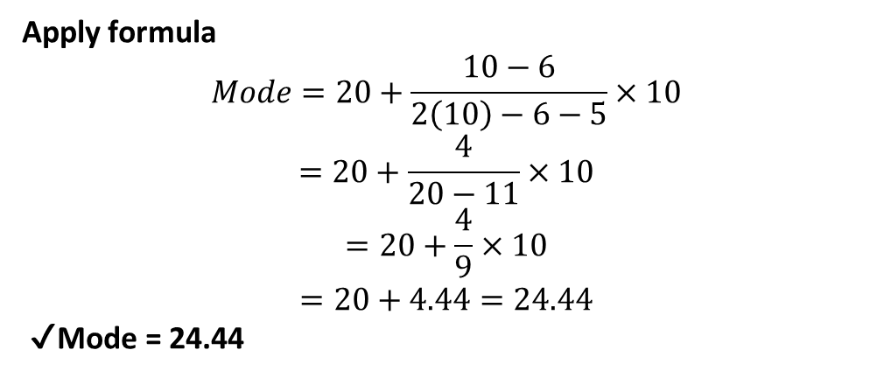
Note:
  If modal class = last class ⇒ f2 = 0
  If modal class = first class ⇒ f0 = 0
Step 2
Modal class = class having maximum frequency → 20–30
So
l = 20
f1 = 10
f0 = 6
f2 = 5
h = 10
Step 3
Apply formula
$$Mode=20+\frac{10−6}{2\left(10\right)−6−5}×10$$
$$=20+\frac{4}{20−11}×10$$
$$=20+\frac{4}{9}×10$$
$$=20+4.44=24.44$$
✔ Mode = 24.44

Slide 19
Question 1
Class Interval | Frequency
0–10 | 5
10–20 | 8
20–30 | 12
30–40 | 7
40–50 | 8
Question 3
Class Interval | Frequency
0–20 | 3
20–40 | 11
40–60 | 18
60–80 | 9
80–100 | 4
Question 2
Class Interval | Frequency
5–15 | 6
15–25 | 9
25–35 | 14
35–45 | 10
45–55 | 6
55–65 | 5
Find
  Mean
  Median
  Mode

Slide 20
Dispersion
What is Dispersion
Dispersion = how spread out the data are
Range
Interquartile Range (IQR)
Variance
Standard Deviation (SD)
Coefficient of Variation (CV
difference between max and min.
(SD / Mean) × 100%; shows relative spread.
sqrt(variance). Population: σ, Sample: s.
Q3 − Q1 (spread of middle 50%).
average of squared deviations from mean.
Population variance uses N in denominator (σ²).
Sample variance uses (n−1) in denominator (s²)

Slide 21
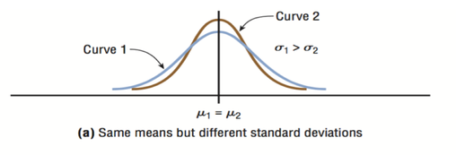
Measures of Dispersion – Why We Need Them
Two datasets can have same mean but different variability.
Dispersion tells us how spread out the data is.
Key measures: Range, Variance, Standard Deviation, Quartiles, IQR, Percentiles, CV.

Slide 22
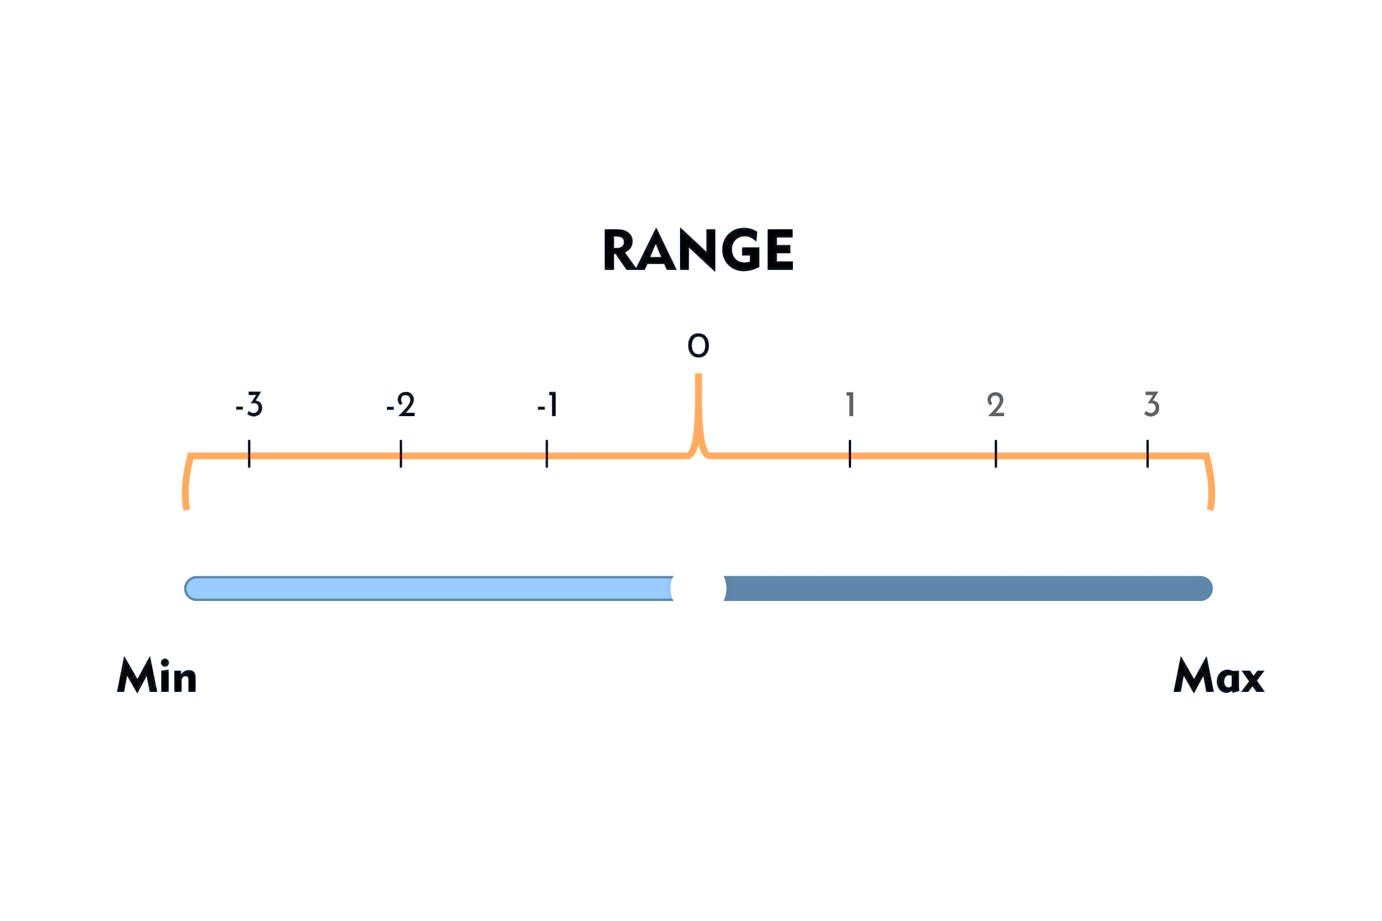
Dispersion – Range
Definition: Difference between maximum and minimum value.
Formula: Range = Max – Min
Example: Values = 10, 12, 15, 13, 20 → Range = 20 – 10 = 10
In Excel: =MAX(A2:A6)-MIN(A2:A6)
Simple but sensitive to outliers.

Slide 23
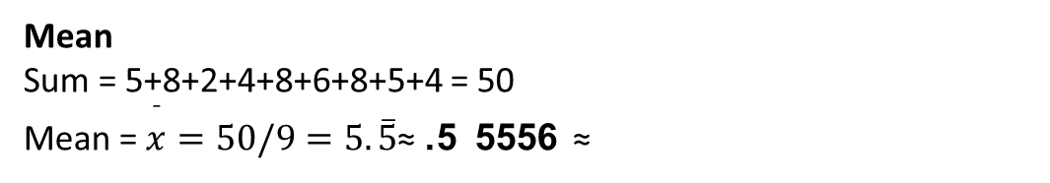
Dispersion – Range
Formula: Range = max(X) − min(X)
Excel: =MAX(range) - MIN(range)
Problem: Discrite
5, 8, 2, 4, 8, 6, 8, 5, 4
Solution:
Step 1 — arrange (sorted)
Sorted: 2, 4, 4, 5, 5, 6, 8, 8, 8
N = 9
Range
Range = max - min = 8 - 2 = 6
Mean
Sum = 5+8+2+4+8+6+8+5+4 = 50
Mean = $\overset{ˉ}{x}=50/9=5.\overset{‾}{5}$≈ 5. 5556 ≈
6

Slide 24
Range for Continuous (Grouped) Data
Range=Highest Upper Limit−Lowest Lower Limit
Because in grouped data we don’t have exact min and max values—so we use class boundaries.
Class Interval
0–10
10–20
20–30
30–40
40–50
Class
5–15
15–25
25–35
Range = 50 − 0 = 50
Range = 35 − 5 = 30

Slide 25
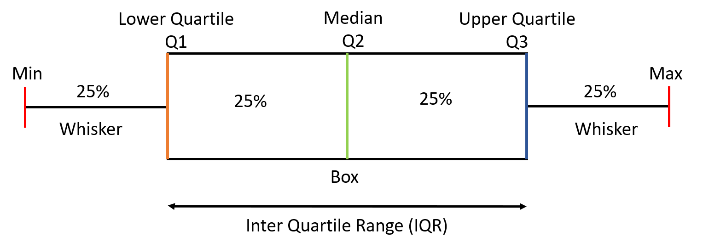
Quartiles, Percentiles & IQR
Quartiles split data into 4 parts:
  • Q1: 25th percentile
  • Q2: 50th percentile (Median)
  • Q3: 75th percentile
Percentiles: e.g., 90th percentile (P90) – value below which 90% of data lies.
Interquartile Range (IQR) = Q3 - Q1; measures middle 50% spread.
In Excel:
  • Q1: =QUARTILE.INC(A2:A11,1)
  • Q2: =QUARTILE.INC(A2:A11,2)
  • Q3: =QUARTILE.INC(A2:A11,3)
  • Percentile: =PERCENTILE.INC(A2:A11,0.9)

Slide 26
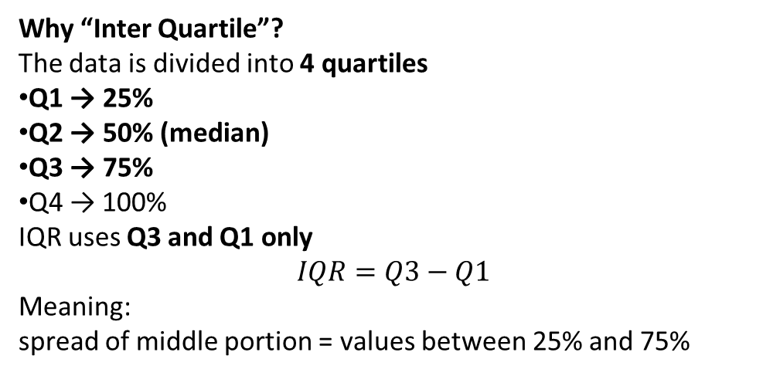
IQR = Inter Quartile Range
What is IQR?
IQR = Inter Quartile Range
It measures how spread out the middle 50% of values are.
So instead of looking at the entire data, IQR only looks at the core/central region of the data (without extremes).
Why “Inter Quartile”?
The data is divided into 4 quartiles
Q1 → 25%
Q2 → 50% (median)
Q3 → 75%
Q4 → 100%
IQR uses Q3 and Q1 only
$$IQR=Q3−Q1$$
Meaning:
spread of middle portion = values between 25% and 75%

Slide 27
🔷 Why AI and Machine Learning need IQR?
Because
models work best when data is clean
outliers mislead learning
outliers produce wrong predictions
noise increases errors
So before training:
we remove outliers using IQR ✔
🔷 IQR is used everywhere in AI:
✔ anomaly detection
✔ fraud detection
✔ feature engineering
✔ distribution analysis
✔ data preprocessing
✔ model performance improvement
✔ Summary in 5 lines
IQR measures central spread
uses only middle 50%
avoids extreme values
ideal for skewed data
best method to detect outliers

Slide 28
Example A — Odd N
Data:
5, 8, 2, 4, 8, 6, 8, 5, 4
Sorted: 2, 4, 4, 5, 5, 6, 8, 8, 8
IQR (Q1, Q3) — method:
Median (Q2) position = (n+1)/2 = (9+1)/2 = 5 → median is 5th value = 5
Lower half (values before median): 2,4,4,5 → Q1 = median of these 4 values = average of 2nd & 3rd = (4 + 4)/2 = 4
Upper half (after median): 6,8,8,8 → Q3 = median of these 4 = average of 2nd & 3rd = (8 + 8)/2 = 8
IQR = Q3 − Q1 = 8 − 4 = 4
Example B — Even N
Data:
12, 15, 11, 14, 10, 13, 16, 18
Step 1 — sort
Sorted: 10, 11, 12, 13, 14, 15, 16, 18
N = 8
IQR (Q1 and Q3) — using the common method where lower half = first n/2 values and upper half = last n/2 values:
Lower half = 10,11,12,13 → Q1 = median of these = (11 + 12)/2 = 11.5
Upper half = 14,15,16,18 → Q3 = (15 + 16)/2 = 15.5
IQR = 15.5 − 11.5 = 4.0

Slide 29


Q1, Q3 and IQR step-by-step using the grouped formula
To find Q1 we use
$$Q_{1}=L+\frac{\frac{N}{4}−F}{f}×h$$
To find Q3
$$Q_{3}=L+\frac{\frac{3N}{4}−F}{f}×h$$
Symbol | Meaning
L | lower boundary of quartile class
N | total frequency
F | cumulative frequency before quartile class
f | frequency of quartile class
h | class width
DATA
Class | f
0–10 | 6
10–20 | 8
20–30 | 14
30–40 | 12
40–50 | 10
Total | 50
So here
$$N=50$$

Slide 30

Step–1 : Find cumulative frequency
Class | f | c.f
0–10 | 6 | 6
10–20 | 8 | 14
20–30 | 14 | 28
30–40 | 12 | 40
40–50 | 10 | 50
Step – 2 :
Find Q1
Symbol | Value
L | 10
F | 6
f | 8
h | 10
So Q1 lies in cumulative frequency >12.5 = 10–20 class

Slide 31
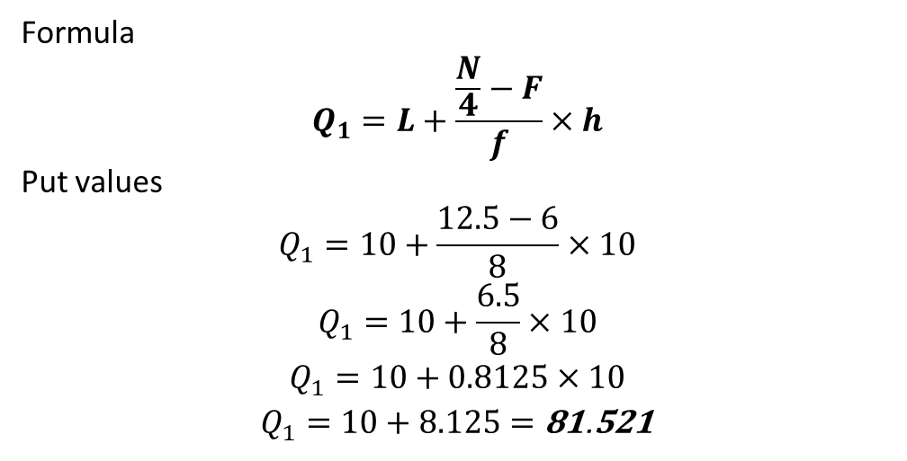
Symbol | Value
L | 10
F | 6
f | 8
h | 10
Formula
$$Q_{1}=L+\frac{\frac{N}{4}−F}{f}×h$$
Put values
$$Q_{1}=10+\frac{12.5−6}{8}×10$$
$$Q_{1}=10+\frac{6.5}{8}×10$$
$$Q_{1}=10+0.8125×10$$
$$Q_{1}=10+8.125=\text{18}\text{.}\text{125}$$

Slide 32
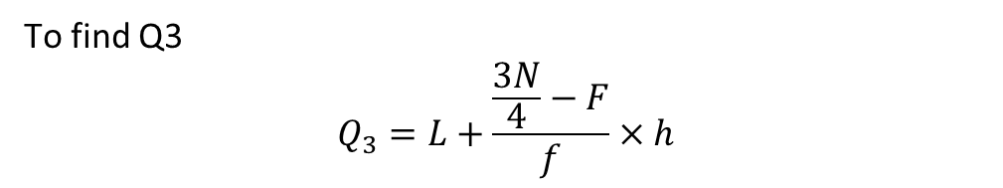

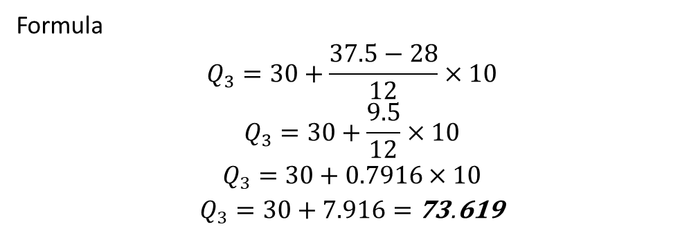
Step – 3 :
Find Q3
Symbol | Value
L | 30
F | 28
f | 12
h | 10
⭐ Find Q3
$$Q3=\frac{3N}{4}=\frac{150}{4}=37.5$$
Look in cumulative frequency >37.5 → 30–40 class
To find Q3
$$Q_{3}=L+\frac{\frac{3N}{4}−F}{f}×h$$
Formula
$$Q_{3}=30+\frac{37.5−28}{12}×10$$
$$Q_{3}=30+\frac{9.5}{12}×10$$
$$Q_{3}=30+0.7916×10$$
$$Q_{3}=30+7.916=\text{37}\text{.}\text{916}$$

Slide 33

⭐ Find IQR
$$IQR=Q3−Q1$$
$$IQR=37.916−18.125=\text{19}\text{.}\text{791}$$
Middle 50% values of data lie within a spread of 19.79 units
Why we use IQR?
🟢 used to measure spread
It shows how spread the central 50% of values are
🟢 not affected by extreme values
Better than range because range includes extreme values.
🟢 used in skewed data
When data is skewed, IQR gives better idea than mean and SD.

Slide 34
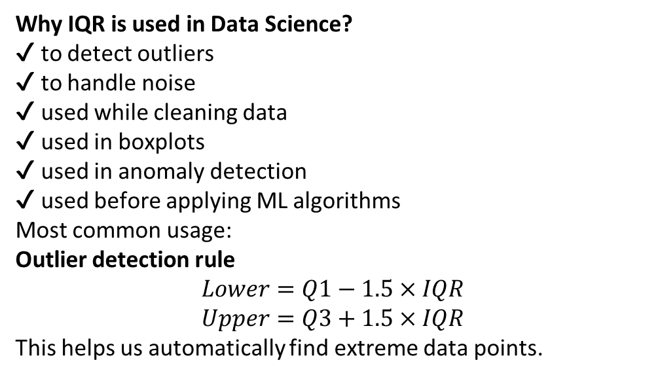
What does IQR tell us?
✔ how tightly packed the central data is
✔ measure of variability
✔ less affected by extreme values
✔ more reliable than range
Why IQR is used in Data Science?
✔ to detect outliers
✔ to handle noise
✔ used while cleaning data
✔ used in boxplots
✔ used in anomaly detection
✔ used before applying ML algorithms
Most common usage:
Outlier detection rule
$$Lower=Q1−1.5×IQR$$
$$Upper=Q3+1.5×IQR$$
This helps us automatically find extreme data points.
Why is IQR important?
Because real world data has outliers
Examples:
salary data
hospital expenses
house price
height/weight
customer purchase amount
traffic speed
machine readings etc.
Range, variance, standard deviation—all get influenced by outliers.
But IQR avoids extreme values
so it gives a robust statistical spread

Slide 35
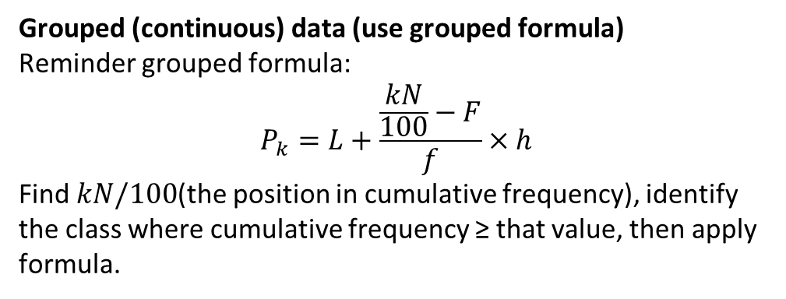
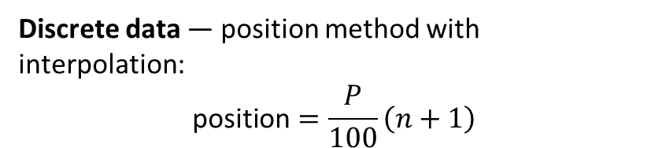
PERCENTILES
⭐ What are Percentiles?
Percentiles divide a dataset into 100 equal parts.
So each percentile represents 1% of the ordered data.
Examples:
P50 = the value below which 50% of the data lies
P90 = the value below which 90% of the data lies
P10 = means 10% are below this point
Discrete data (showing position, interpolation)
Discrete data — position method with interpolation:
$$\text{position}=\frac{P}{100}\left(n+1\right)$$
Symbol | Meaning
L | lower limit of percentile class
K | percentile (like 25 for P25)
N | total freq
F | cumulative freq before that class
f | frequency of that class
h | class width.
Grouped (continuous) data (use grouped formula)
Reminder grouped formula:
$$P_{k}=L+\frac{\frac{kN}{100}−F}{f}×h$$
Find $kN/100$(the position in cumulative frequency), identify the class where cumulative frequency ≥ that value, then apply formula.

Slide 36
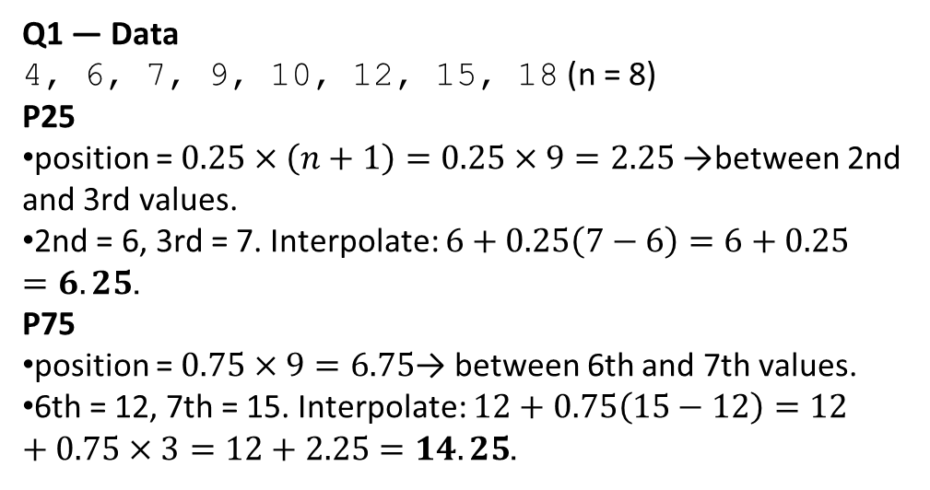
Discrete data (showing position, interpolation)
Q1
Find P25 and P75 for the following data:
Values:
4, 6, 7, 9, 10, 12, 15, 18
Q1 — Data
4, 6, 7, 9, 10, 12, 15, 18 (n = 8)
P25
position = $0.25×\left(n+1\right)=0.25×9=2.25$→ between 2nd and 3rd values.
2nd = 6, 3rd = 7. Interpolate: $6+0.25\left(7−6\right)=6+0.25=6.25$.
P75
position = $0.75×9=6.75$→ between 6th and 7th values.
6th = 12, 7th = 15. Interpolate: $12+0.75\left(15−12\right)=12+0.75×3=12+2.25=14.25$.

Slide 37
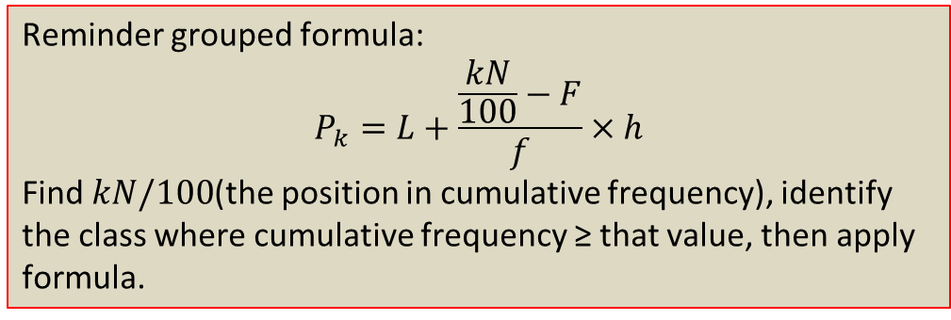
Continuous Grouped Data Percentile Questions
Class Interval | f
0–10 | 4
10–20 | 6
20–30 | 10
30–40 | 15
40–50 | 5
Find P30 and P70
Reminder grouped formula:
$$P_{k}=L+\frac{\frac{kN}{100}−F}{f}×h$$
Find $kN/100$(the position in cumulative frequency), identify the class where cumulative frequency ≥ that value, then apply formula.

Slide 38
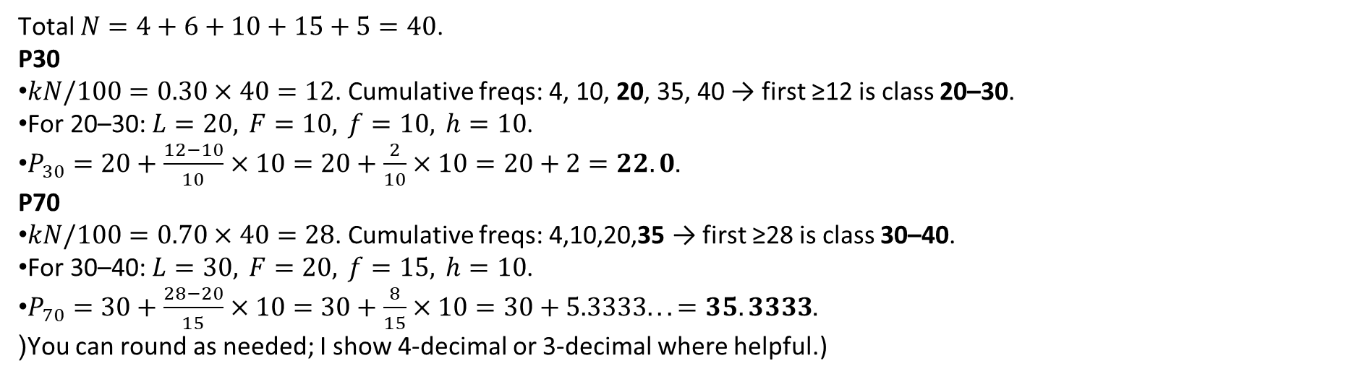
Class | f | c.f
0–10 | 4 | 4
10–20 | 6 | 10
20–30 | 10 | 20
30–40 | 15 | 35
40–50 | 5 | 40
Total $N=4+6+10+15+5=40$.
P30
$kN/100=0.30×40=12$. Cumulative freqs: 4, 10, 20, 35, 40 → first ≥12 is class 20–30.
For 20–30: $L=20, F=10, f=10, h=10$.
$P_{30}=20+\frac{12−10}{10}×10=20+\frac{2}{10}×10=20+2=22.0$.
P70
$kN/100=0.70×40=28$. Cumulative freqs: 4,10,20,35 → first ≥28 is class 30–40.
For 30–40: $L=30, F=20, f=15, h=10$.
$P_{70}=30+\frac{28−20}{15}×10=30+\frac{8}{15}×10=30+5.3333...=35.3333$.
(You can round as needed; I show 4-decimal or 3-decimal where helpful.)

Slide 39
Q1
Find P40 and P90
Values:
2, 2, 5, 8, 10, 12, 15, 25, 26, 28
Q2
Find P30 and P60
Values:
5, 7, 7, 8, 9, 11, 12, 14
Q4
Find P25 & P90
Class Interval | f
0–10 | 3
10–20 | 5
20–30 | 7
30–40 | 10
40–50 | 15
Q3.
Find P10, P50, P75
Class Interval | f
0–5 | 5
5–10 | 8
10–15 | 12
15–20 | 20
20–25 | 10
ANSWERS:
Q1: P40 = 8.8, P90 = 27.8
Q2: P30 = 7.0, P60 = 9.8
Q3: P10 = 5.3125, P50 = 15.625, P75 = 19.0625
Q4: P25 = 22.8571, P90 = 47.3333

Slide 41
Variance & Standard Deviation
Variance measures average squared distance from mean.
Sample variance: s² = Σ(xi - x̄)² / (n-1)
Standard deviation: s = √s² (same units as data).
Example idea: marks in a test – higher s means marks are more spread out.
Excel:
  • Sample variance: =VAR.S(A2:A11)
  • Sample std dev: =STDEV.S(A2:A11)
Use to compare spread between two datasets with similar scale.
[IMAGE PLACEHOLDER: bell curve with ±1σ, ±2σ, ±3σ marked]

Slide 42

Variance
What is Variance?
Variance tells you how spread out the data is from the mean.
Simply:
How much values are deviating away from the average.
If values are near mean → variance small
If values far apart → variance large
Mathematical meaning
Variance = average of squared deviations from the mean
Why squared?
If we sum just (x - mean), positives and negatives cancel.
So we square them → make all values positive.

Slide 43
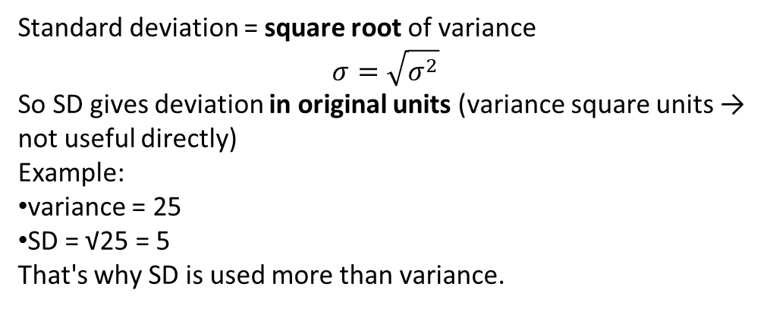
Standard Deviation (SD)
Standard deviation = square root of variance
$$σ=\sqrt{σ^{2}}$$
So SD gives deviation in original units (variance square units → not useful directly)
Example:
variance = 25
SD = √25 = 5
That's why SD is used more than variance.
Imagine heights:
Everyone exactly 170 cm → variance = 0
Some 150, some 190 → variance big
So it measures spread (variation).

Slide 44
Why these used in Data Science / AI?
Used for:
✔ feature scaling
✔ evaluating spread
✔ standard scores
✔ normal distribution
✔ anomaly detection
✔ control limits
✔ forecasting
✔ machine learning models
Examples:
StandardScaler uses mean & SD
Z-score uses SD
Gaussian distribution uses SD
Outlier detection depends on SD
Variance and SD basically describe uncertainty/spread/noise in data.

Slide 45

POPULATION VS SAMPLE
✔ Sample
Sample = only some part of the data
Example:
100 students from a school (not all Indian students)
20 customers from Amazon
30 patients from a hospital
We don’t know the entire population
so we estimate the variance
✔ Population
Population = ALL the data you want to study
Example:
All students in India
All employees in a company
All items produced in a month
If we have every value, we can calculate PERFECT variance → Population variance

Slide 46



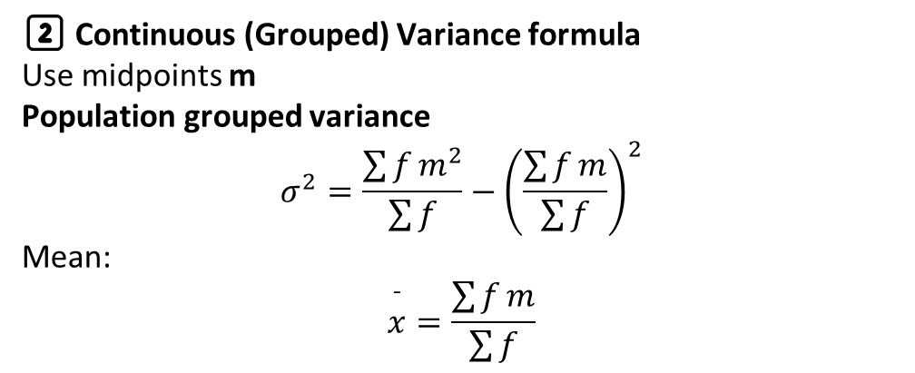
1️⃣ Discrete data variance formula
Population variance
Sample variance
Mean:
$$\overset{ˉ}{x}=\frac{\sum{x}}{n}$$
2️⃣ Continuous (Grouped) Variance formula
Use midpoints m
Population grouped variance
$$σ^{2}=\frac{\sum{f}m^{2}}{\sum{f}}−{\left(\frac{\sum{f}m}{\sum{f}}\right)}^{2}$$
Mean:
$$\overset{ˉ}{x}=\frac{\sum{f}m}{\sum{f}}$$
Population variance = actual spread
Sample variance = estimated spread

Slide 47


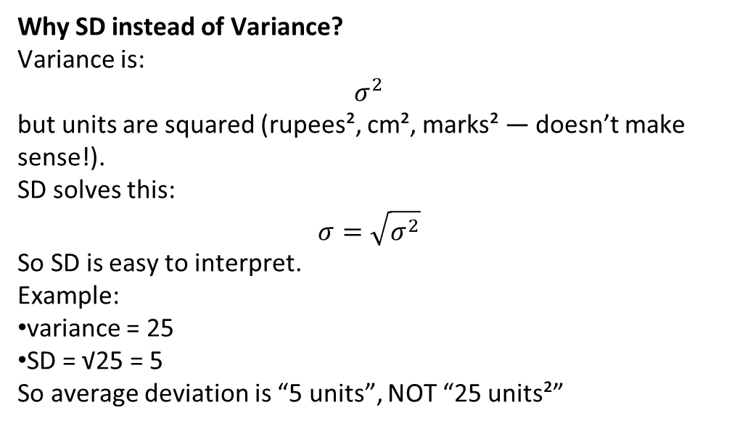
Standard Deviation (SD)
What is SD?
Standard deviation measures how spread out the values are from the mean.
👉 Low SD → values are close to mean
👉 High SD → values are widely spread from mean
It tells you the dispersion, but in the same units as the original data (variance is in squared units).
⭐ SD Formula (Population)
⭐ SD Formula (Sample)
Why SD instead of Variance?
Variance is:
$$σ^{2}$$
but units are squared (rupees², cm², marks² — doesn’t make sense!).
SD solves this:
$$σ=\sqrt{σ^{2}}$$
So SD is easy to interpret.
Example:
variance = 25
SD = √25 = 5
So average deviation is “5 units”, NOT “25 units²”

Slide 48
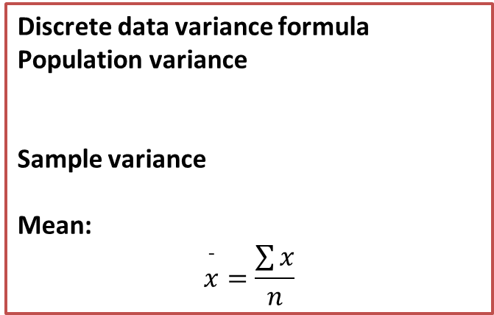
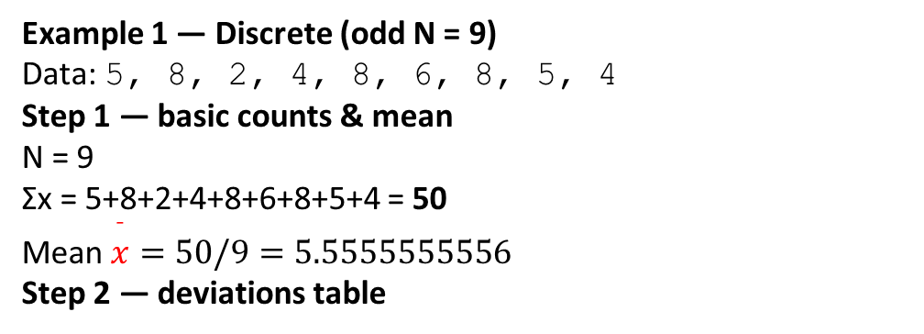
Discrete data variance formula
Population variance
Sample variance
Mean:
$$\overset{ˉ}{x}=\frac{\sum{x}}{n}$$
Discrete
Example 1 — Discrete (odd N = 9)
Data: 5, 8, 2, 4, 8, 6, 8, 5, 4
Step 1 — basic counts & mean
N = 9
Σx = 5+8+2+4+8+6+8+5+4 = 50
Mean $\overset{ˉ}{x}=50/9=5.5555555556$
Step 2 — deviations table
x | x − mean | (x − mean)²
5 | −0.5555556 | 0.30864198
8 | 2.4444444 | 5.97530864
2 | −3.5555556 | 12.64197531
4 | −1.5555556 | 2.41975309
8 | 2.4444444 | 5.97530864
6 | 0.4444444 | 0.19753086
8 | 2.4444444 | 5.97530864
5 | −0.5555556 | 0.30864198
4 | −1.5555556 | 2.41975309
Σ (x − mean)² = 36.22222222

Slide 49

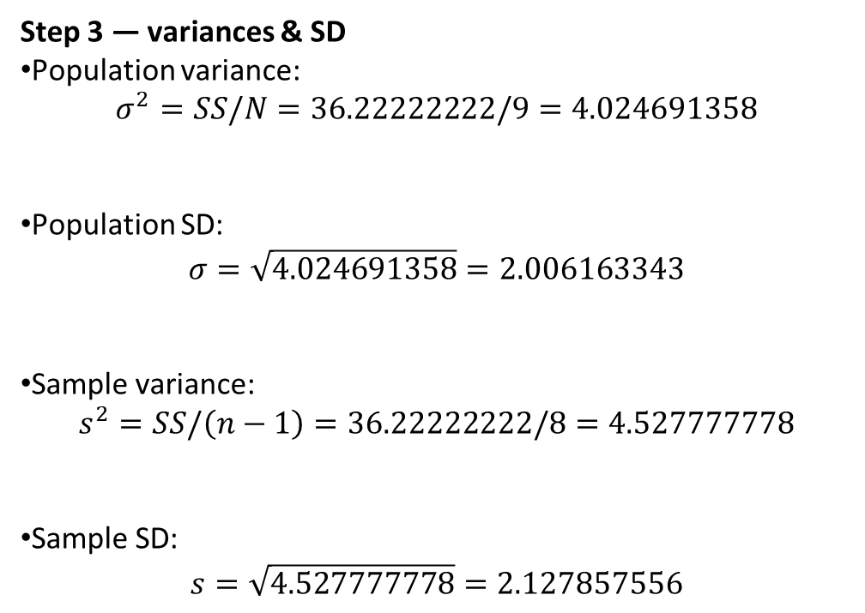
sum of squares (SS)
Step 3 — variances & SD
Population variance:
$σ^{2}=SS/N=36.22222222/9=4.024691358$
Population SD:
$σ=\sqrt{4.024691358}=2.006163343$
Sample variance:
$s^{2}=SS/\left(n−1\right)=36.22222222/8=4.527777778$
Sample SD:
$s=\sqrt{4.527777778}=2.127857556$

Slide 50
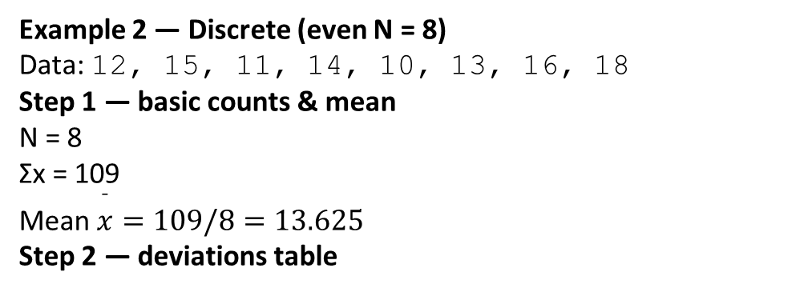
Example 2 — Discrete (even N = 8)
Data: 12, 15, 11, 14, 10, 13, 16, 18
Step 1 — basic counts & mean
N = 8
Σx = 109
Mean $\overset{ˉ}{x}=109/8=13.625$
Step 2 — deviations table
x | x − mean | (x − mean)²
12 | −1.625 | 2.640625
15 | 1.375 | 1.890625
11 | −2.625 | 6.890625
14 | 0.375 | 0.140625
10 | −3.625 | 13.140625
13 | −0.625 | 0.390625
16 | 2.375 | 5.640625
18 | 4.375 | 19.140625
Σ (x − mean)² = 49.875

Slide 51
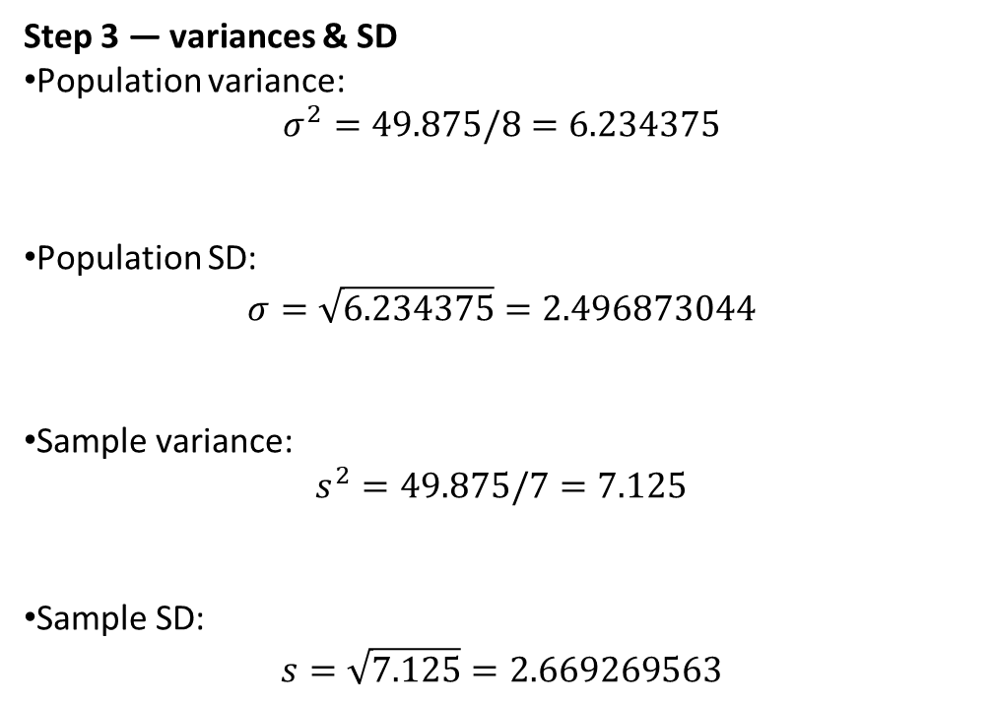
Step 3 — variances & SD
Population variance:
$σ^{2}=49.875/8=6.234375$
Population SD:
$σ=\sqrt{6.234375}=2.496873044$
Sample variance:
$s^{2}=49.875/7=7.125$
Sample SD:
$s=\sqrt{7.125}=2.669269563$

Slide 52
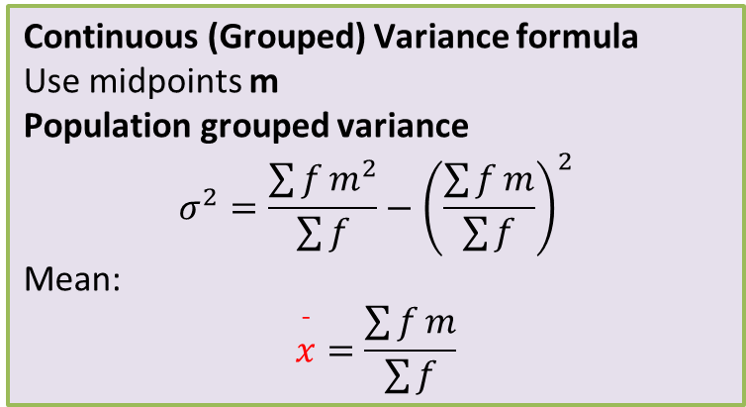
Grouped (continuous)
Continuous (Grouped) Variance formula
Use midpoints m
Population grouped variance
$$σ^{2}=\frac{\sum{f}m^{2}}{\sum{f}}−{\left(\frac{\sum{f}m}{\sum{f}}\right)}^{2}$$
Mean:
$$\overset{ˉ}{x}=\frac{\sum{f}m}{\sum{f}}$$
Example 3 — Grouped (continuous) — (h = 10)
Class | f
0–10 | 4
10–20 | 6
20–30 | 10
30–40 | 5
40–50 | 5
Step 1 — midpoints m
m = 5, 15, 25, 35, 45

Slide 53
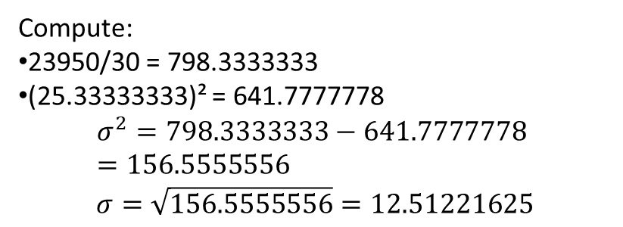
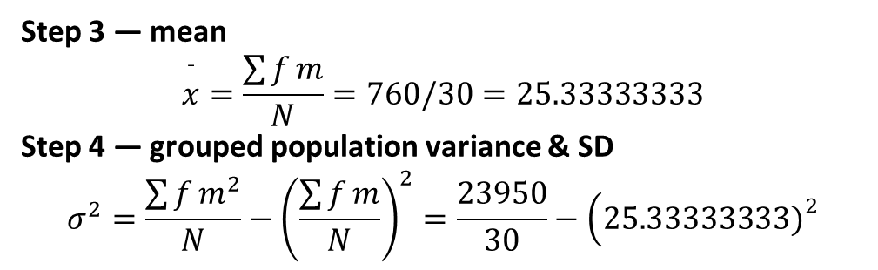
Step 2 — compute f×m and f×m²
Class | f | m | f×m | m² | f×m²
0–10 | 4 | 5 | 20 | 25 | 100
10–20 | 6 | 15 | 90 | 225 | 1,350
20–30 | 10 | 25 | 250 | 625 | 6,250
30–40 | 5 | 35 | 175 | 1,225 | 6,125
40–50 | 5 | 45 | 225 | 2,025 | 10,125
Σf = N = 30
Σfm = 760
Σfm² = 23,950
Step 3 — mean
$$\overset{ˉ}{x}=\frac{\sum{f}m}{N}=760/30=25.33333333$$
Step 4 — grouped population variance & SD
$$σ^{2}=\frac{\sum{f}m^{2}}{N}−{\left(\frac{\sum{f}m}{N}\right)}^{2}=\frac{23950}{30}−\left(25.33333333{\left.)\right.}^{2}\right.$$
Compute:
23950/30 = 798.3333333
(25.33333333)² = 641.7777778
$$σ^{2}=798.3333333−641.7777778 =156.5555556$$
$$σ=\sqrt{156.5555556}=12.51221625$$

Slide 54
Example 4 — Grouped (continuous) — (h = 5)
Class | f
0–5 | 5
5–10 | 8
10–15 | 12
15–20 | 20
20–25 | 10
Step 1 — midpoints m
m = 2.5, 7.5, 12.5, 17.5, 22.5
Step 2 — compute f×m and f×m²
Class | f | m | f×m | m² | f×m²
0–5 | 5 | 2.5 | 12.5 | 6.25 | 31.25
5–10 | 8 | 7.5 | 60 | 56.25 | 450
10–15 | 12 | 12.5 | 150 | 156.25 | 1,875
15–20 | 20 | 17.5 | 350 | 306.25 | 6,125
20–25 | 10 | 22.5 | 225 | 506.25 | 5,062.5
Σf = N = 55
Σfm = 797.5
Σfm² = 13,543.75

Slide 55
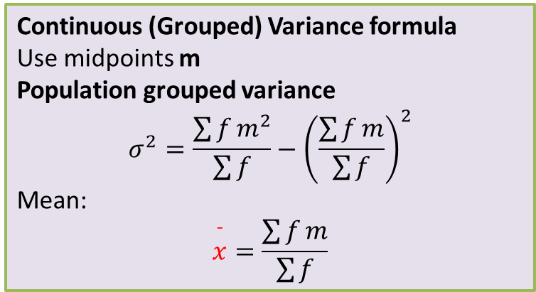
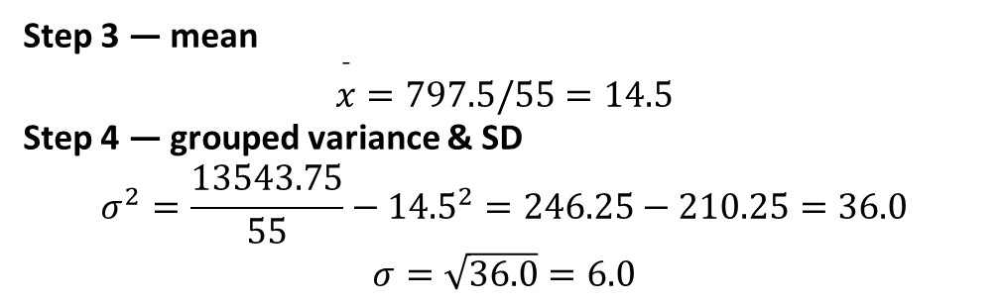
Continuous (Grouped) Variance formula
Use midpoints m
Population grouped variance
$$σ^{2}=\frac{\sum{f}m^{2}}{\sum{f}}−{\left(\frac{\sum{f}m}{\sum{f}}\right)}^{2}$$
Mean:
$$\overset{ˉ}{x}=\frac{\sum{f}m}{\sum{f}}$$
Step 3 — mean
$$\overset{ˉ}{x}=797.5/55=14.5$$
Step 4 — grouped variance & SD
$$σ^{2}=\frac{13543.75}{55}−{14.5}^{2}=246.25−210.25=36.0$$
$$σ=\sqrt{36.0}=6.0$$

Slide 56
A. DISCRETE DATA (2 Questions)
Q1 – Test Scores (Scenario)
A teacher records marks of 6 students:
50, 60, 70, 80, 60, 50
Q2 – Machine Production (Scenario)
Daily production units of a machine:
12, 15, 14, 18, 21
B. CONTINUOUS (GROUPED DATA)
Q3 – Worker Monthly Salary (Scenario)
Salary Range | Frequency
10–20 | 4
20–30 | 7
30–40 | 6
40–50 | 3
Q4 – Student Height Distribution
Height (cm) | Frequency
140–150 | 3
150–160 | 8
160–170 | 12
170–180 | 5

Slide 57
ANSWERS
Q3.
Variance
= 95.35
SD
= 9.76
Q4.
Variance
= 109.69
SD
= 10.47
Q1.
Population variance
= 133.33
Population SD
= 11.55
Q2.
Sample Variance
= 12.5
Sample SD
= 3.53

Slide 59
Coefficient of Variation (CV)
Definition: Relative measure of spread = Standard Deviation / Mean.
Formula: CV = s / x̄
Usage: Compare variability between datasets with different means/units.
Example: Compare sales variability of two products with different average sales.
In Excel: =STDEV.S(A2:A11)/AVERAGE(A2:A11)

Slide 60
Coefficient of Variation (CV)
⭐ Coefficient of Variation (CV)
One of the most important metrics in statistics, data science, ML, and AI when comparing variability between datasets.
✅ 1. What is Coefficient of Variation?
The Coefficient of Variation (CV) measures how large the standard deviation is compared to the mean.
It tells:
👉 “How much variability exists relative to the average value?”
So, it is a relative measure of dispersion, not an absolute one.
Why CV is Used? (Purpose)
✔ Compare variability between two datasets with different units or different means.
Example:
Dataset A mean = 10, SD = 2
Dataset B mean = 100, SD = 5
Even though SD of B is higher, variability relative to mean may be lower.
CV helps compare this fairly.

Slide 61
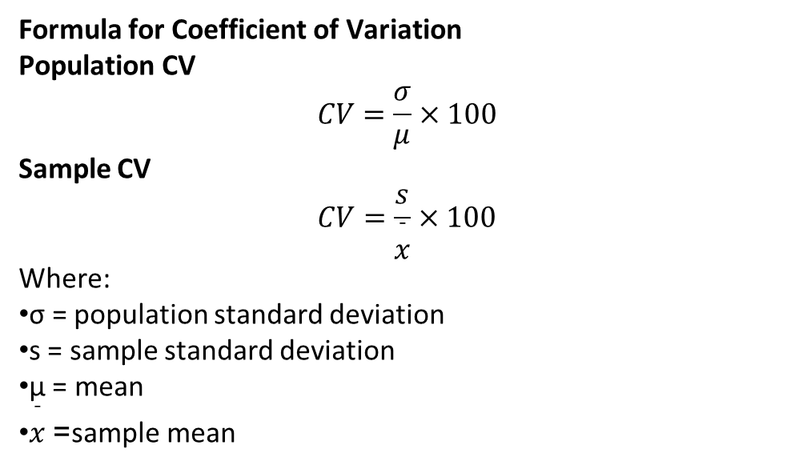
Formula for Coefficient of Variation
Population CV
$$CV=\frac{σ}{μ}×100$$
Sample CV
$$CV=\frac{s}{\overset{ˉ}{x}}×100$$
Where:
σ = population standard deviation
s = sample standard deviation
μ = mean
$\overset{ˉ}{x}$= sample mean

Slide 62

Example 1: Daily Sales (Discrete Data)
A shop recorded the number of items sold in 7 days:
12, 15, 18, 20, 17, 16, 14
👉 Find:
Mean
Standard Deviation
Coefficient of Variation (CV)
Data:
12, 15, 18, 20, 17, 16, 14
n = 7
Step 1 — Mean
$$\overset{ˉ}{x}=\frac{12+15+18+20+17+16+14}{7}$$
$$\overset{ˉ}{x}=\frac{112}{7}=16$$

Slide 63


Step 2 — Standard Deviation (Population SD)
Use:
x | x − mean | (x − mean)²
12 | -4 | 16
15 | -1 | 1
18 | 2 | 4
20 | 4 | 16
17 | 1 | 1
16 | 0 | 0
14 | -2 | 4
∑(x−xˉ)2=42
$$σ=\sqrt{\frac{42}{7}}=\sqrt{6}=2.45$$

Slide 64

Step 3 — Coefficient of Variation
$$CV=\frac{σ}{\overset{ˉ}{x}}×100$$
$$CV=\frac{2.45}{16}×100=15.31\%$$
🔹 Final Answer (Q1)
Mean = 16
SD = 2.45
CV = 15.31%

Slide 65
CONTINUOUS (GROUPED) DATA
Q3 – Employee Salary Distribution
Class | f
10–20 | 5
20–30 | 8
30–40 | 12
40–50 | 10
50–60 | 5
Step 1 — Midpoints (m)
10–20 → 15
20–30 → 25
30–40 → 35
40–50 → 45
50–60 → 55

Slide 66
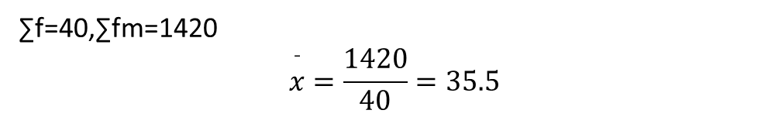

Step 2 — Mean Formula
$$\overset{ˉ}{x}=\frac{\sum{f}m}{\sum{f}}$$
Compute fm:
m | f | fm
15 | 5 | 75
25 | 8 | 200
35 | 12 | 420
45 | 10 | 450
55 | 5 | 275
∑f=40,∑fm=1420
$$\overset{ˉ}{x}=\frac{1420}{40}=35.5$$

Slide 67
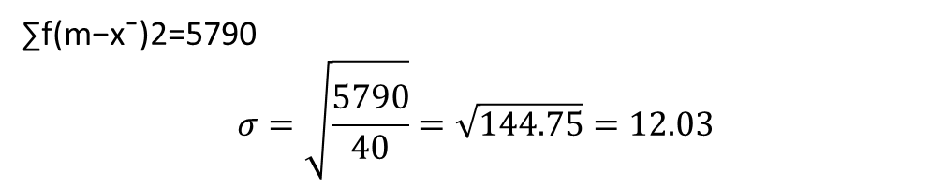
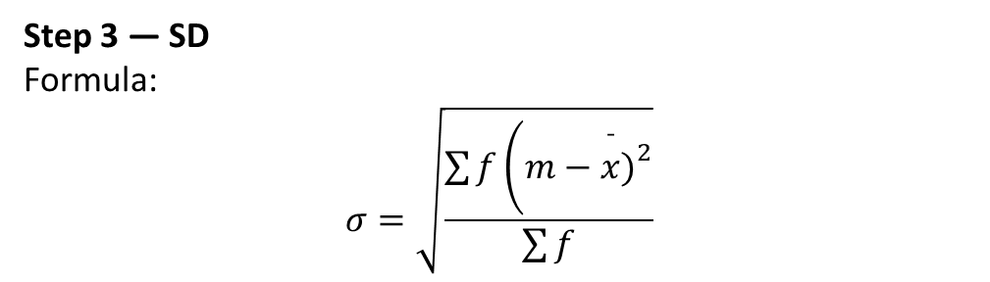
Step 3 — SD
Formula:
$$σ=\sqrt{\frac{\sum{f}\left(m−\overset{ˉ}{x}{\left.)\right.}^{2}\right.}{\sum{f}}}$$
m | f | m−mean | (m−mean)² | f × (m−mean)²
15 | 5 | -20.5 | 420.25 | 2101.25
25 | 8 | -10.5 | 110.25 | 882
35 | 12 | -0.5 | 0.25 | 3
45 | 10 | 9.5 | 90.25 | 902.5
55 | 5 | 19.5 | 380.25 | 1901.25
∑f(m−xˉ)2=5790
$$σ=\sqrt{\frac{5790}{40}}=\sqrt{144.75}=12.03$$

Slide 68
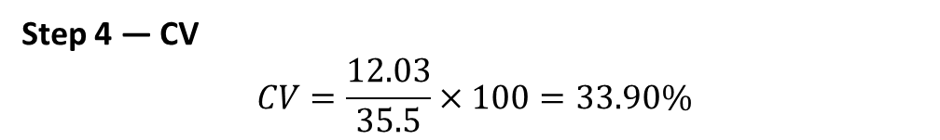
Step 4 — CV
$$CV=\frac{12.03}{35.5}×100=33.90\%$$
🔹 Final Answer (Q3)
Mean = 35.5
SD = 12.03
CV = 33.90%

Slide 69

Measure | What It Means | Formula (Basic) | Units | What It Tells You | When to Use | Example Interpretation
Variance (σ² or s²) | Average of squared deviation from mean |  | Squared units | How spread out the data points are | When measuring overall dispersion; in statistical models | Variance = 100 → On average, values deviate “100 units²” from mean
Standard Deviation (σ or s) | Square root of variance |  | Same units as data | How far each value is from the mean on average | To understand real-world variability easily | SD = 10 → Values vary ~10 units around mean
Coefficient of Variation (CV) | Relative variation (SD compared to mean) | (SD / Mean )​×100 | Percentage | Variation in proportion to the mean | To compare datasets with different units or scales | CV = 25% → Data has moderate variability
σ=sqrt(σ2)​

Slide 70
Q2 – Machine Output (Discrete Data)
A machine produced the following units over 6 hours:
25, 30, 28, 32, 29, 26
👉 Find:
Mean
Standard Deviation
Coefficient of Variation (CV)
Q4 – Student Height Distribution
Height (cm) | Frequency
140–150 | 4
150–160 | 10
160–170 | 15
170–180 | 8
180–190 | 3
👉 Find:
Mean (Grouped)
Standard Deviation (Grouped)
CV

Slide 71
Shape
Skewness, Kurtosis, Normal distribution check
Shape of a Distribution
The shape of a data distribution tells us how the data values are spread and clustered.
The main shape measures are:
Skewness – symmetry
Kurtosis – peakedness / tail behavior
Normal Distribution check – whether data follows a bell shape

Slide 72
Shape – Skewness
Skewness measures asymmetry of the distribution.
Right-skewed (positive): long tail on right (e.g., income data).
Left-skewed (negative): long tail on left.
Skewness ≈ 0: roughly symmetric.
In Excel: =SKEW(A2:A11)
[IMAGE PLACEHOLDER: diagrams of left/right skewed distributions]

Slide 73

Skewness (Measure of Symmetry)
What is Skewness?
Skewness shows whether data is symmetric or tilted (skewed) to one side.
Types of Skewness
Type | Description | Example
Zero skewness | Perfectly symmetric | Height of people
Positive skewness | Tail towards right | Income, salary
Negative skewness | Tail towards left | Marks in easy exam
Visual Understanding
Positive Skewed (Right-skewed)
Mean > Median > Mode
Negative Skewed (Left-skewed)
Mean < Median < Mode

Slide 74


Formula for Skewness (Karl Pearson)
$$\text{Skewness}=\frac{\text{Mean}−\text{Mode}}{\text{Standard} \text{Deviation}}$$
OR
$$\text{Skewness}=\frac{3\left(\text{Mean}−\text{Median}\right)}{\text{Standard} \text{Deviation}}$$
Example Sum – Skewness
Question:
Mean = 60
Median = 55
Standard Deviation = 10
Answer:
$$\text{Skewness}=\frac{3\left(60−55\right)}{10}=\frac{15}{10}=1.5$$
Interpretation:
✔ Positively skewed distribution
Interpretation Table
Skewness Value | Meaning
0 | Symmetrical
> 0 | Positively skewed
< 0 | Negatively skewed

Slide 75

Shape – Kurtosis & Normal Distribution Check
Kurtosis measures 'tailedness' – how heavy the tails are.
High kurtosis: more extreme values (heavy tails).
Low kurtosis: fewer extreme values (light tails).
In Excel: =KURT(A2:A11)
Normal distribution check:
  • Histogram looks bell-shaped
  • Mean ≈ median
  • Many values within ±1, ±2 standard deviations
[IMAGE PLACEHOLDER: normal distribution curve]

Slide 76
Kurtosis (Measure of Peakedness)
What is Kurtosis?
Kurtosis measures how peaked or flat a distribution is compared to a normal distribution.
Types of Kurtosis
Type | Shape | Meaning
Mesokurtic | Normal | Average peak
Leptokurtic | High peak | More outliers
Platykurtic | Flat | Fewer extreme values

Slide 77
Kurtosis Values
Kurtosis Value | Distribution
= 3 | Mesokurtic
> 3 | Leptokurtic
< 3 | Platykurtic
Note: Some books use Excess Kurtosis
Excess Kurtosis = Kurtosis − 3
Example Sum – Kurtosis
Question:
Calculated Kurtosis = 4.8
Answer:
4.8 > 3 → Leptokurtic
Interpretation:
✔ Distribution is highly peaked
✔ More extreme values (outliers)

Slide 78
Another Example
Question:
Excess Kurtosis = −1.2
Answer:
Negative value → Platykurtic distribution

Slide 79

Normal Distribution Check
What is Normal Distribution?
A Normal Distribution is a bell-shaped, symmetric distribution where:
Mean = Median = Mode
Skewness = 0
Kurtosis = 3
Properties of Normal Distribution
Rule | Explanation
68% rule | Data within ±1 SD
95% rule | Data within ±2 SD
99.7% rule | Data within ±3 SD

Slide 80
Example Question – Normal Check
Question:
Mean = 50
Median = 50
Mode = 50
Skewness = 0
Kurtosis = 3
Answer:
✔ Data follows Normal Distribution
Practical Normality Check (for students)
Data is approximately normal if:
Skewness is between −1 and +1
Kurtosis is between 2 and 4

Slide 81
Univariate vs Multivariate Analysis
What is Univariate Analysis?
Analysis of one variable only.
Example | Tool
Student marks | Mean, Median
Age | Histogram
Salary | Skewness
What is Multivariate Analysis?
Analysis of two or more variables together.
Example | Tool
Height vs Weight | Correlation
Sales vs Profit | Regression
Marks vs Attendance | Scatter plot

Slide 82
Comparison Table
Feature | Univariate | Multivariate
No. of variables | One | Two or more
Purpose | Describe | Relationship
Examples | Mean, SD | Correlation
Charts | Histogram | Scatter plot

Slide 83
Example Question
Question:
Studying only student marks → which analysis?
Answer:
✔ Univariate Analysis
Question:
Studying marks and attendance together?
Answer:
✔ Multivariate Analysis

Slide 84
Descriptive Data Visualization in Excel
Histogram: shows distribution of numeric data.
Boxplot: shows median, quartiles, outliers.
Bar chart: compares categories (categorical data).
Scatter plot: shows relationship between two numeric variables.
Frequency table: counts in each category or bin.
Excel:
  • Histogram/Boxplot: Insert → Statistical Chart
  • Bar/Column chart: Insert → Column/Bar
  • Scatter: Insert → Scatter

Slide 85
Inferential Statistics – Overview (Context Only)
Goal: Use sample to infer about population.
Key ideas:
  • Population vs sample
  • Sampling error & Central Limit Theorem
  • Confidence Intervals (estimate ranges)
  • Hypothesis Testing (t-test, chi-square, ANOVA)
Use after descriptive stats when you want to generalize or test decisions.

Slide 86
Excel – Descriptive Statistics ToolPak
ToolPak can give a full summary in one step:
Steps:
  1. Enable Analysis ToolPak (File → Options → Add-ins).
  2. Data → Data Analysis → Descriptive Statistics.
  3. Select input range, check 'Summary statistics'.
Output: mean, median, mode, std dev, variance, range, skewness, kurtosis, etc.
[IMAGE PLACEHOLDER: Excel Descriptive Statistics dialog & output table]

Slide 87
Summary – What Students Should Learn Today
Why statistics is essential in data science.
Difference between descriptive and inferential statistics.
Descriptive Statistics:
  • Central Tendency: Mean, Median, Mode
  • Dispersion: Variance, Std Dev, Range, Quartiles, Percentiles, IQR, CV
  • Shape: Skewness, Kurtosis, Normal check
  • Visualization: Histogram, Boxplot, Bar, Scatter, Frequency tables
Excel functions and charts to compute and visualize all of the above.

